Slide 1
10.2 Affine-Yield Models
劉彥君

Slide 2
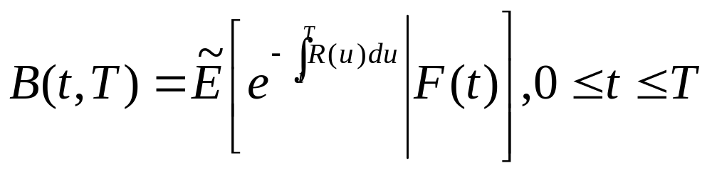
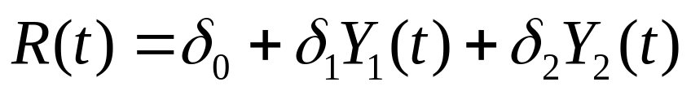
Bond Prices
According to the risk-neutral pricing formula, the price at time t of a zero-coupon bond paying 1 at a latter time T is
R(t) 由 Y₁(t)、Y₂(t) 組成
(10.2.6)

Slide 3
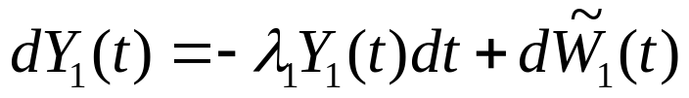

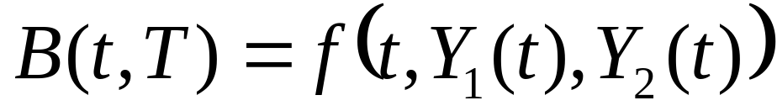
And the solution of the system of stochastic differential equations
Is Markov
➔ There must be some function f(t,y₁,y₂) such that
(10.2.4)
(10.2.5)
(pp.74)

Slide 4
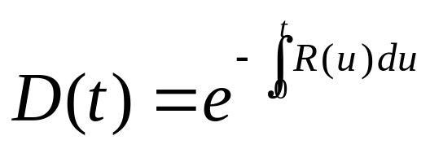


The discount factor
satisfies (see (5.2.18))
迭代上面的條件式：
➔D(t)B(t, T) is a martingale under
➔d(D(t)B(t,T)) 的 dt 項為 0

Slide 5
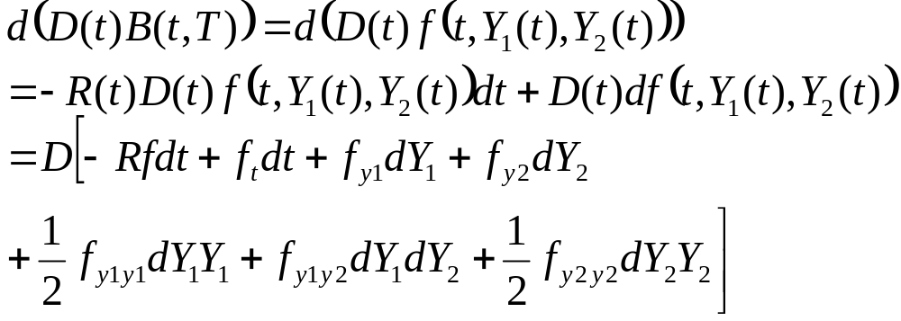
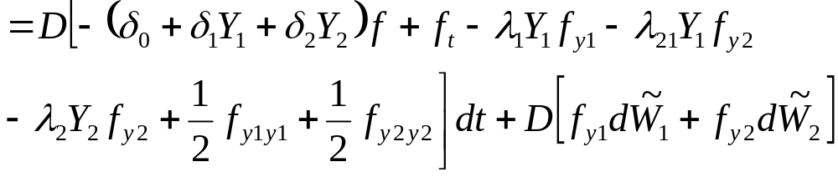
(10.2.4)
(10.2.5)
(10.2.6)

Slide 6
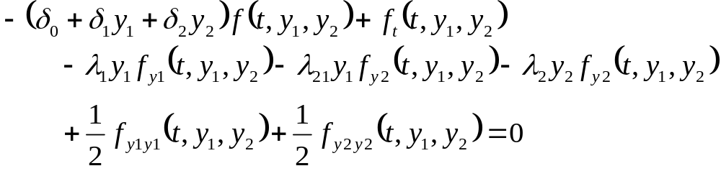


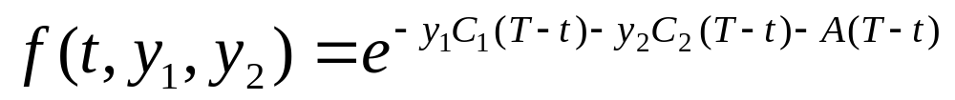
令 dt 項為 0 ，則可得
(10.2.18)
Terminal condition：
To solve this equation, we seek a solution of the affine-yield form
(10.2.20)
for some functions C₁(τ), C₂(τ), and A(τ).
Define τ=T-t to be the relative maturity (i.e., the time until maturity)

Slide 7

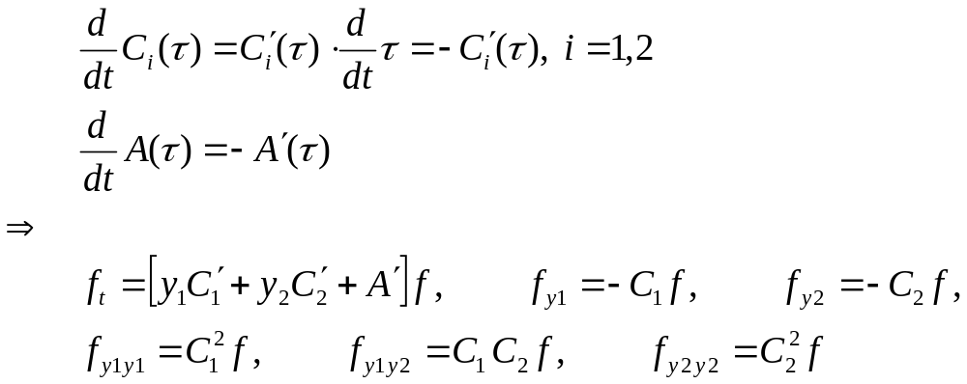
由於模型參數並不相依於 t，而 zero-coupon bond prices 將
透過 τ 相依於 t 。
由 Terminal condition 可得：
Then compute derivatives, where ` denotes differentiation with respect to τ .
微 (10.2.20)

Slide 8
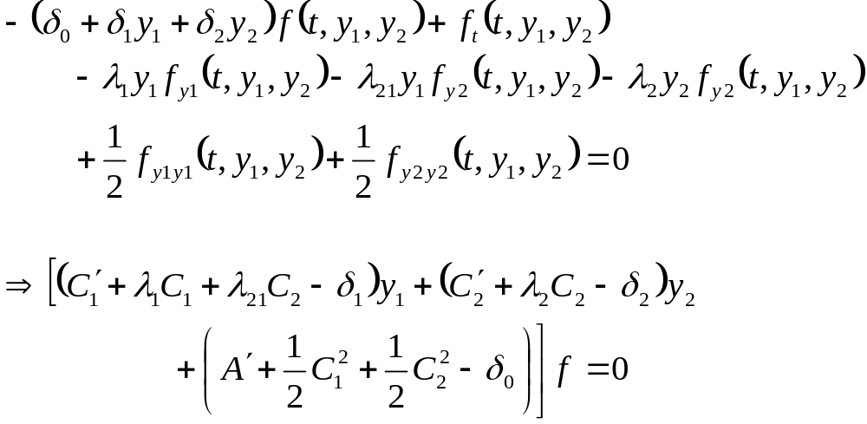
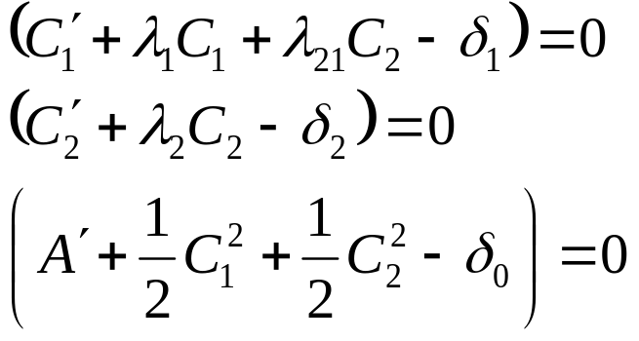
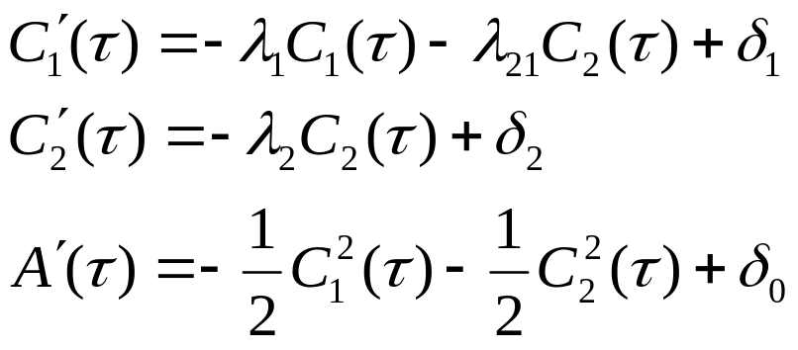

則 (10.2.18)
(10.2.18)
Since it must hold for all y₁ and y₂, thus
(10.2.23)
(10.2.24)
(10.2.25)

Slide 9

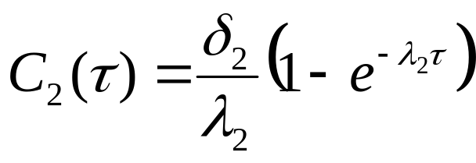
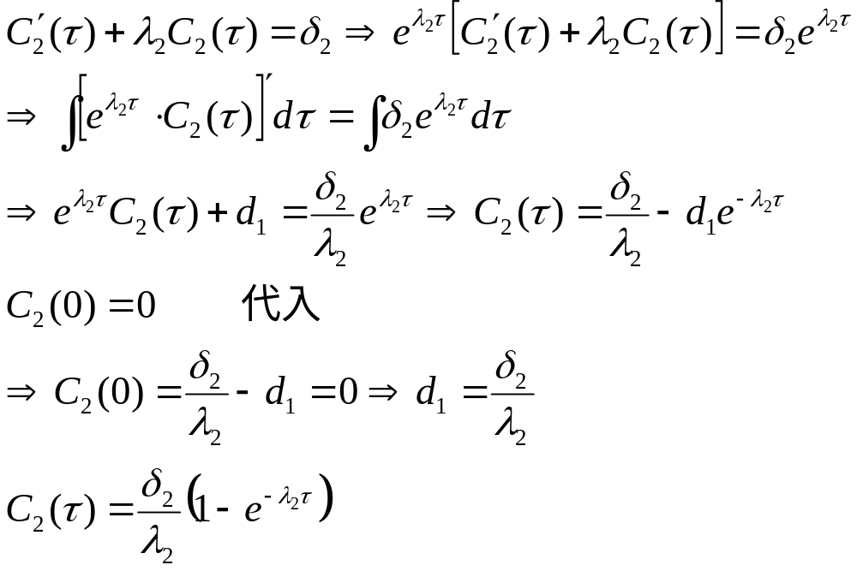
代入 Terminal Condition C₂(0) = 0 可得
(10.2.26)
計算

Slide 10

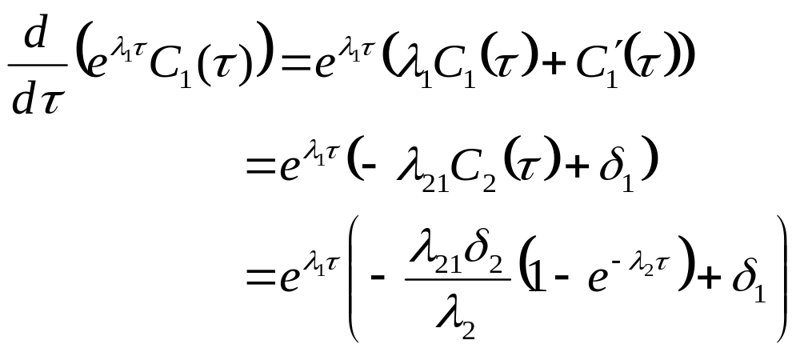
將 (10.2.26) 代入 (10.2.23) 並以 initial condition C₁(0)=0 解方程式
(10.2.23)
(10.2.26)
In particular, (10.2.23) implies

Slide 11
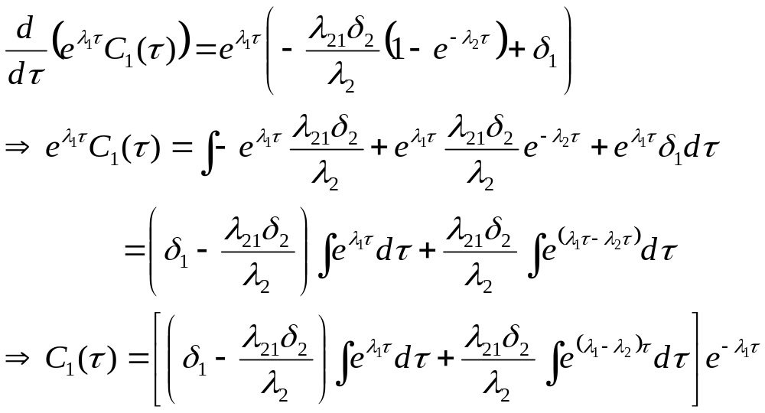
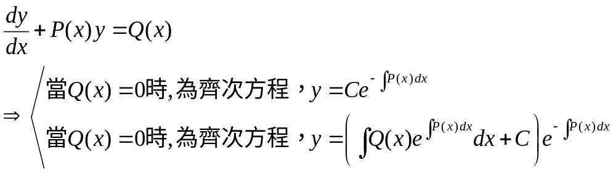
Note 一階線性微分方程：

Slide 12
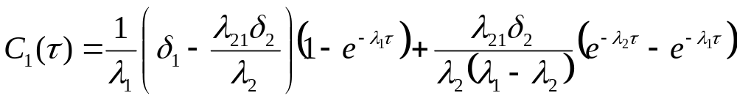
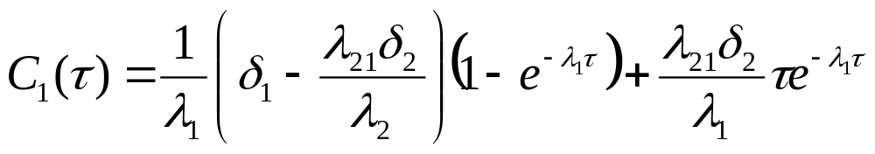
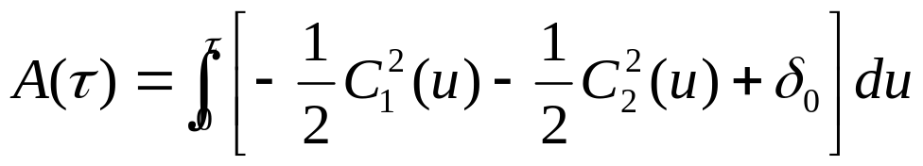
If λ₁≠ λ₂, integration from 0 to τ
(10.2.27)
If λ₁= λ₂, we obtain instead
(10.2.28)
Finally, (10.2.25) and the initial condition A(0)=0 imply
(10.2.29)
and this can be obtained in closed form by a lengthy but straightforward computation.

Slide 13



Short Rate and Long Rate
Fix a positive relative maturity (say, 3 years)
Long rate L(t):
  The yield at time t on the zero-coupon bond with relative maturity (i.e., 到期日 )
一旦我們有一個模型，可以在風險中立測度下計算 short rate R(t)
  For all t>=0，the price of zero-coupon bond is determined by the risk-neutral pricing formula
  The short-rate model alone determines the long rate.
所以我們不可以隨意為 Long rate 寫下 stochastic differential equation
但在任一 affine-yield model，long rate 仍然符合某些 stochastic differential equation.

Slide 14
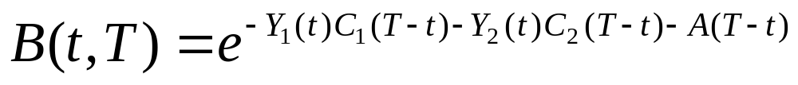
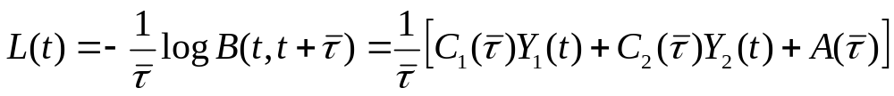
Consider the canonical two-factor Vasicek model.
As in the previous discussion, Zero-coupon bond prices in this model are of the form
where C₁(τ), C₂(τ) and A(τ) are given by (10.2.26)-(10.2.29).
Thus, the long rate at time t is
(10.2.30)
which is an affine function of the canonical factors Y₁(t) and Y₂(t) at time t.

Slide 15

因為 canonical factors 沒有經濟意涵，我們希望使用 R(t) 與 L(t) 作為 model factor
two-factor Vasicek model
(10.2.1)
(10.2.2)
(10.2.3)
目標：X₁(t) ➔ R(t) , X₂(t) ➔L(t)

Slide 16
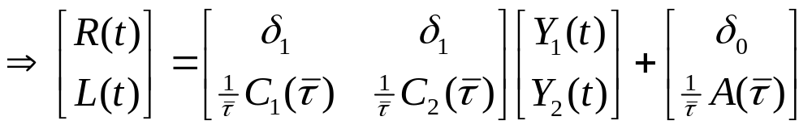
首先將 (10.2.6) 和 (10.2.30) 寫成 vector notation:
(10.2.6)
(10.2.30)
(10.2.31)
We wish to solve this system for (Y₁(t), Y₂(t))

Slide 17
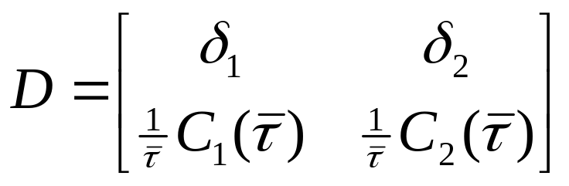
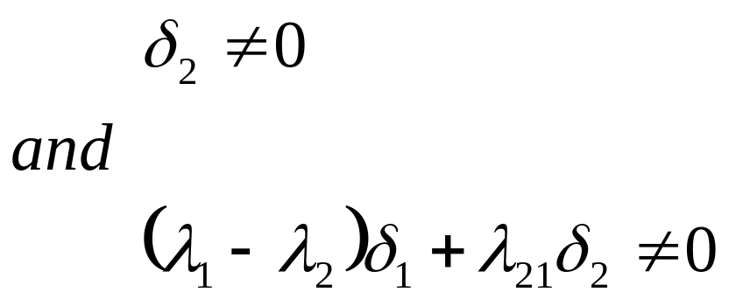
Lemma 10.2.2
The matrix
is nonsingular if and only if
(10.2.32)

Slide 18


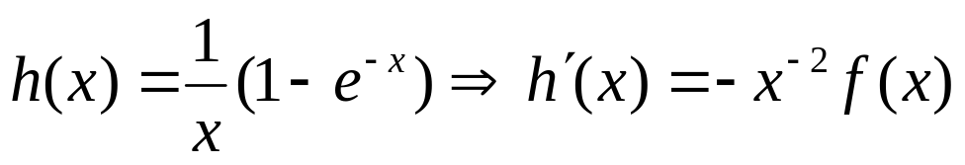
Consider
for which f(0)=0 and f ’(x)=xe^{-x} > 0, for all x > 0
Define
h’(x) is strictly negative , for all x > 0
h(x) is strictly decreasing on (0, ∞)
To examine the nonsingular of D, consider the first case λ₁≠ λ₂
We can use (10.2.26) and (10.2.27)
(10.2.26)
(10.2.27)

Slide 19
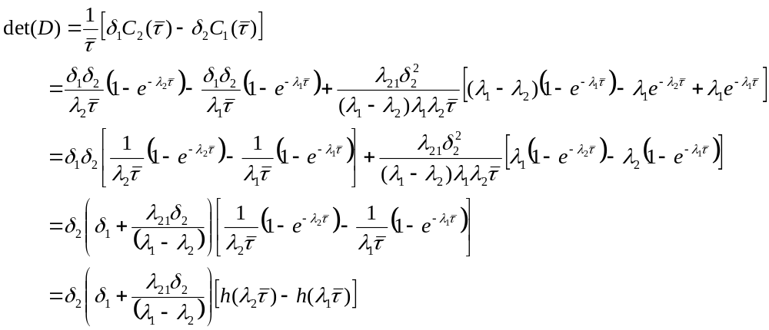

Because λ₁ ≠λ₂, h is strictly decreasing, h(λ₁)≠ h(λ₂)
D is nonzero
if and only if δ₂≠0 and
(10.2.32)

Slide 20
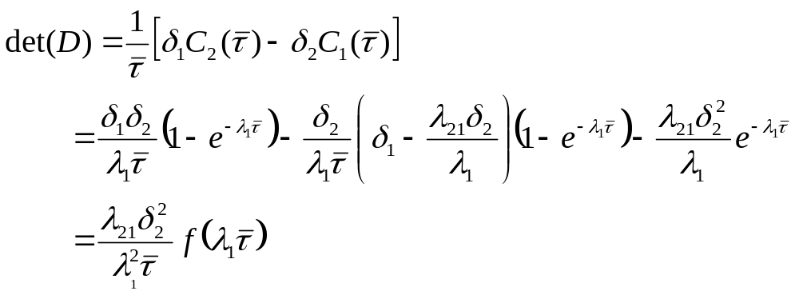
Next consider the case λ₁=λ₂
(10.2.26)
(10.2.28)
imply
is equivalent to
(10.2.32)
D is nonzero if and only if (10.2.32) holds.

Slide 21
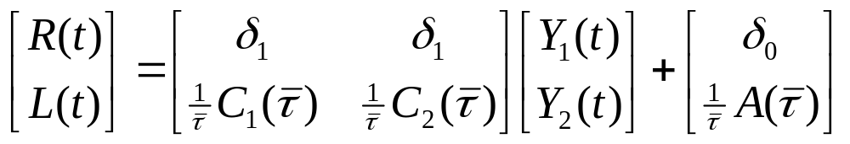
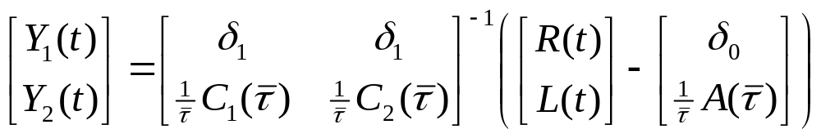
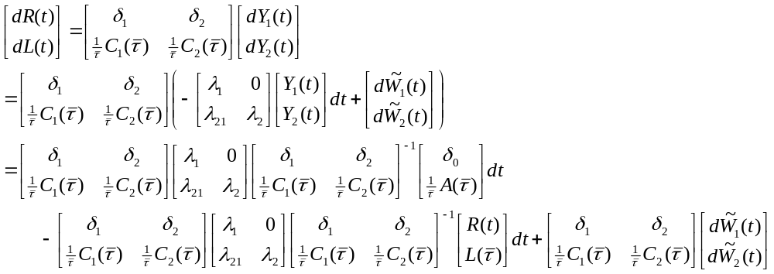
Under the assumptions of Lemma 10.2.2, we can invert
(10.2.31)
into
(10.2.33)
Then we can compute
(10.2.4)
(10.2.5)

Slide 22
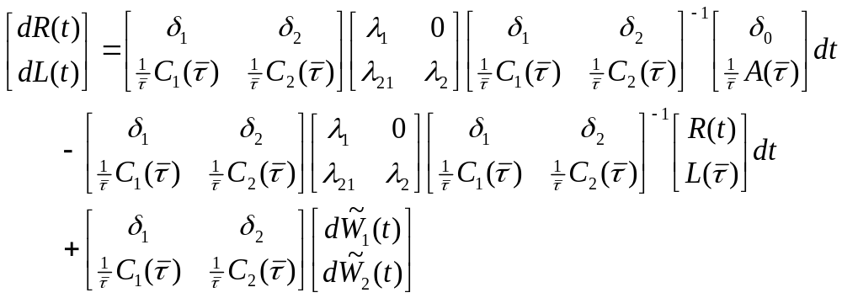
two-factor Vasicek model
(10.2.1)
(10.2.2)
(10.2.3)
目標：X₁(t) ➔ R(t) , X₂(t) ➔L(t)

Slide 23
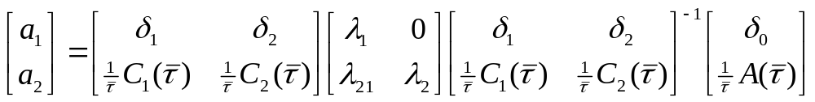
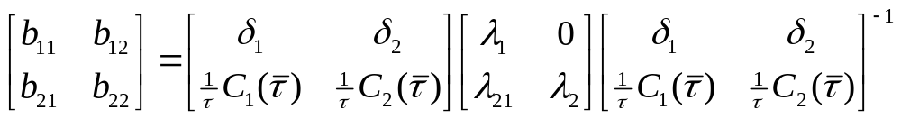
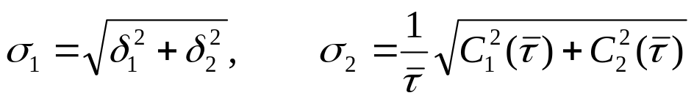
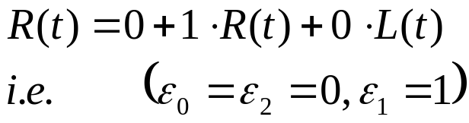
The a₁, a₂ in (10.2.1) and (10.2.2) is
The matrix B is
and the eigenvalues of B are λ₁ > 0, λ₂ > 0. With
The processes
are the Brownian motions appearing in (10.2.1) and (10.2.2)

Slide 24
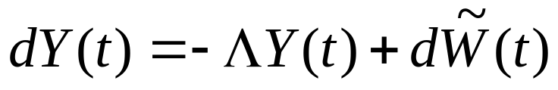
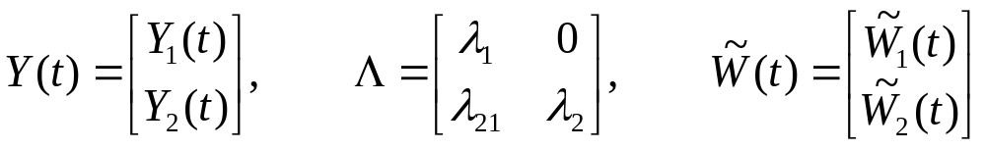
Gaussian Factor Processes
Reform (10.2.4)~(10.2.5)
(10.2.4)
(10.2.5)
the canonical two-factor Vasicek model in vector notation is
(10.2.34)
where
Recall that λ₁ > 0, λ₂ > 0
There is a closed-form solution to this matrix differential equation.

Slide 25
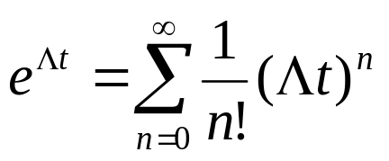
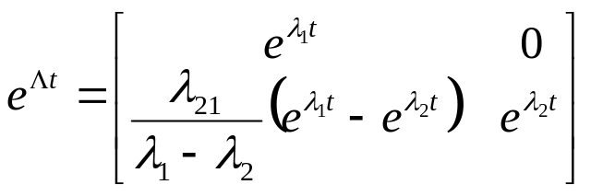
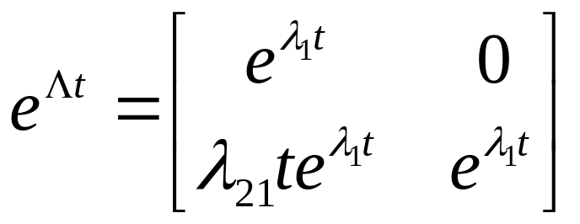
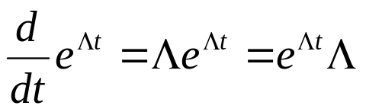
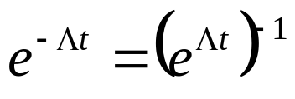
To derive this solution, we first form the matrix exponential
e^{Λt} defined by
where (Λt)=I, the 2 x 2 identity matrix.
Lemma 10.2.3
If λ₁ ≠λ₂ ,then
If λ₁ =λ₂ ,then
(10.2.35)
(10.2.36)
In either case,
(10.2.37)
Where the derivate is defined componentwise, and
(10.2.38)
where e^{-Λt} is obtained by replacing λ₁, λ₂, and λ₂₁ in the formula e^{Λt} by -λ₁, -λ₂, and -λ₂₁, respectively.

Slide 26
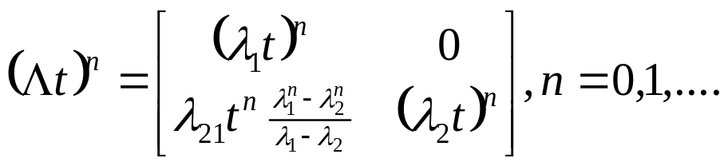
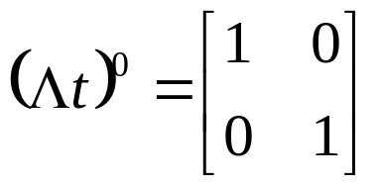
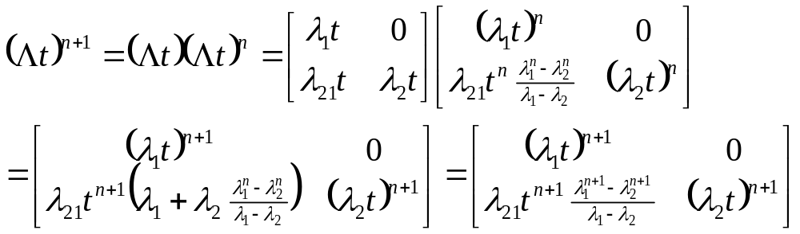
We consider first the case λ₁ ≠λ₂ .We claim that in this case
(10.2.39)
使用數學歸納法
n=0:
Assume (10.2.39) is true for some value of n.
which is (10.2.39) with n replaced by n+1.

Slide 27
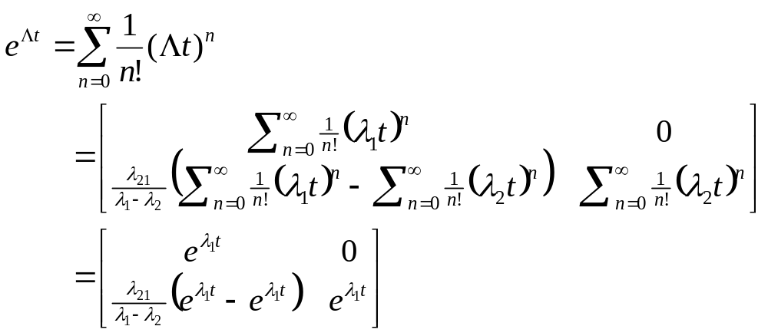
Having thus established (10.2.39) for all values of n, we have
This is (10.2.35)

Slide 28
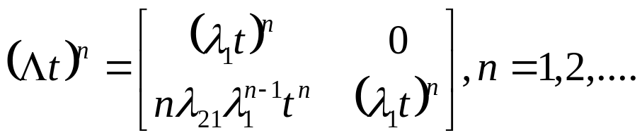
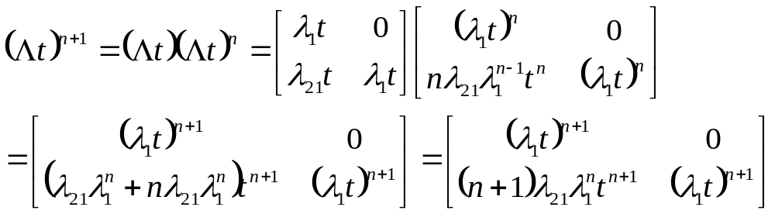
We next consider the case λ₁ =λ₂ .We claim in this case that
(10.2.40)
使用數學歸納法
n=0:
Assume (10.2.40) is true for some value of n.
which is (10.2.40) with n replaced by n+1.

Slide 29


Having thus established (10.2.40) for all values of n, we have
(10.2.41)
But
Substituting this into (10.2.41), we obtain (10.2.36).
(10.2.36)

Slide 30




Now prove
and
(10.2.37)
(10.2.38)
When λ₁ ≠λ₂, we have
and
When λ₁ =λ₂,
and
The verification of (10.2.37) and (10.2.38) can be done by straightforward matrix multiplications.

Slide 31



Now we have define
then
代入 (10.2.34)
課本有誤
Integration form 0 to t yields
We solve for
(10.2.42)

Slide 32



If λ₁ ≠λ₂, equation (10.2.42) may be written componentwise as
(10.2.43)
(10.2.44)
If λ₁＝λ₂, then the componentwise form of (10.2.42) is
(10.2.45)
(10.2.46)

Slide 33
nonrandom quantities + Ito integrals of nonrandom integrands
➔the process Y₁(t) and Y₂(t) are Gaussian.
➔R(t) = δ₀+δ₁Y₁(t)+δ₂Y₂(t) is normally distributed.
The statistics of Y₁(t) and Y₂(t) are provided in Exercise 10.1

Slide 34

10.2.2 Two-Factor CIR Model
In the two-factor Vasicek model, the canonical factors Y₁(t) and Y₂(t) are jointly normally distributed.
  Because Y₁(t) and Y₂(t) are driven by independent Brownian motions, they are not perfectly correlated.
➔for all t>0
is a normal random variable with variance
  >0：δ₁ ≠ 0, δ₂ ≠ 0
  =0：δ₁ = δ₂ = 0
In particular, for each t>0,
(10.2.47)
there is a positive probability that R(t) is strictly negative.

Slide 35


In the two-factor Cox-Ingersoll-Ross model (CIR), both factors are guaranteed to be nonnegative at all times almost surely.
We again define the interest rate by (10.2.47) but now assume that
(10.2.48)
(10.2.47)
➔R(0) ≥ 0, and R(t) ≥ 0 for all t ≥ 0 almost surely.

Slide 36


The evolution of the factor processes in the canonical two-factor CIR model is given by
≥0 >0 ≤ 0
(10.2.49)
(10.2.50)
≥0 ≤0 >0
In addition to (10.2.48), we assume
(10.2.51)
although the drift term of (10.2.49) can be negative but these conditions guarantee that
Starting with Y₁(0) ≥ 0 and Y₂(0) ≥ 0, we have Y₁(t) ≥ 0 and Y₂(t) ≥ 0 for all t ≥ 0 almost surely.

Slide 37




The Brownian motions and in (10.2.49) and (10.2.50) are assumed to be independent.
We do not need this assumption to guarantee nonnegativity of Y₁(t) and Y₂(t) but rather to obtain the affine-yield result below; see Remark 10.2.4.
Remark 10.2.4
如果兩個 Brownian motions 的關係係數 ρ≠0, 在令 dt 項係數=0的偏微分方程中會多出一項
將會使得
(10.2.56)-(10.2.58) 無法計算。
所以在一開始即假設兩個 Brownian motions 互相獨立。

Slide 38

Bond Prices
The price at time t of a zero-coupon bond maturing at a later time T must be of the form
for some function f(t, y1, y2). The discounted bond price has differential

Slide 39

Setting the dt term =0, 我們得到偏微分方程式
(10.2.52)
To solve this equation, we seek a solution of the affine-yield form
(10.2.53)
for some C₁(τ), C₂(τ) and A(τ), where τ=T-t.

Slide 40


The terminal condition
(10.2.54)
With ‘ denoting differentiation with respect to τ, we have
Then compute f_{t}, f_{y1}, f_{y2}, f_{y1y1}, f_{y2y2}

Slide 41




(10.2.52) becomes
(10.2.55)
Because (10.2.52) must hold for all y₁ ≥ 0 and y₂ ≥ 0,
➔
(10.2.56)
(10.2.57)
(10.2.58)

Slide 42
The solution to these equations satisfying the initial condition (10.2.54) can be found numerically.
Solving this system of ordinary differential equations numerically is simpler than solving the partial differential equation (10.2.52).

Slide 43
10.2.3 Mixed Model
in the two-factor CIR model,
  Both factors are always nonnegative.
In the two-factor Vasicek model,
  Both factors can become negative.
In the two-factor mixed model,
  one of the factors is always nonnegative
  the other can become negative.

Slide 44


The canonical two-factor mixed model is
≥0 >0
(10.2.59)
>0
(10.2.60)
≥0
≥0
We assume
The Brownian motions and are independent.
Y₁(0) ≥ 0, and we have Y₁(t) ≥ 0 for all t ≥ 0 almost surely.
On the other hand, even if Y₁(t) > 0, Y₂(t) can take negative values for t > 0

Slide 45



The interest rate is defined by
(10.2.61)
In this model, zero-coupon bond prices have the affine-yield form
(10.2.62)
Just as in the two-factor Vasicek model and the two-factor CIR model, the functions C₁(τ), C₂(τ) and A(τ) must satisfy the terminal condition
(10.2.63)
Exercise 10.2 derives the system of ordinary differential equations that determine the functions C₁(τ), C₂(τ) and A(τ) .

